Slide 1

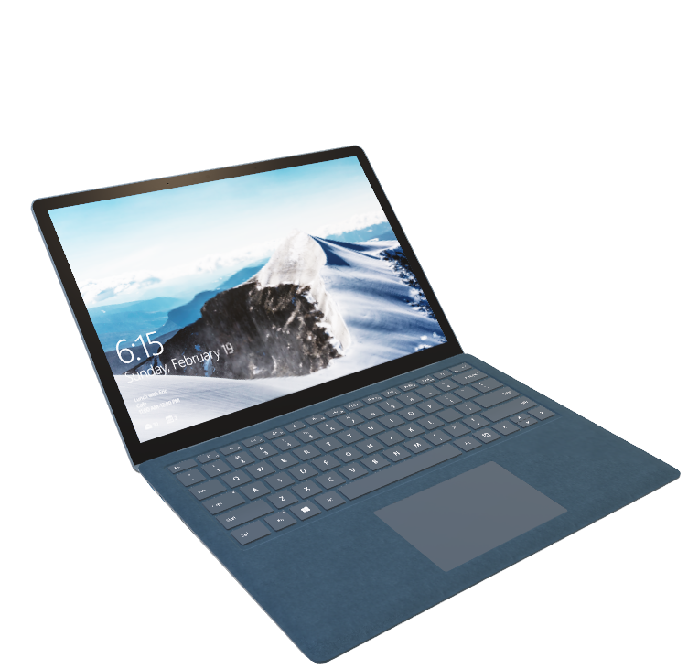
PREDICTION PERFORMERS OF HP LAPTOP USING CUSTOMER REVIEW
AAKASH SHEDGE – 915
RANJEET JADHAV – 916

Slide 2

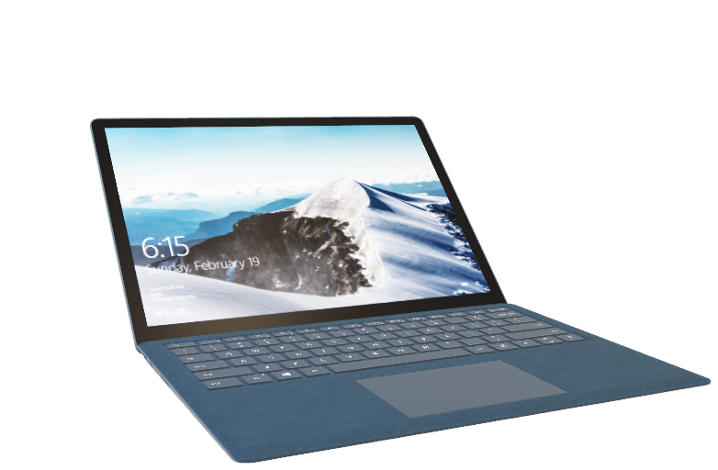
CONTENT
Introduction
Objective
Methodology
Data source & visualization
Statistical Analysis
Conclusion

Slide 3

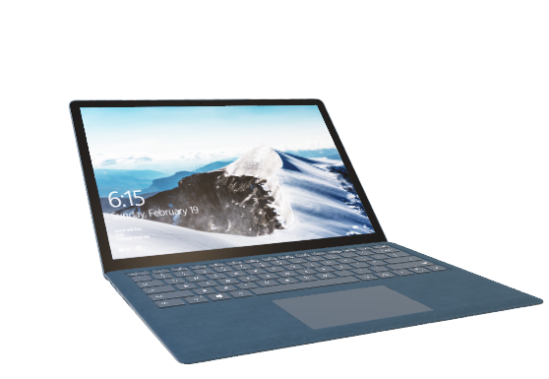
Introduction
As we all know, laptops have become an essential part of our daily lives, enabling us to stay connected, work, learn, and entertain ourselves.
However, with so many options available in the market, it can be challenging to make our product customer friendly. That's where laptop performance prediction comes in, using various techniques and algorithms to estimate the performance of a given laptop configuration.
In this presentation, we will explore the importance of laptop performance prediction, on the basis of after sale reviews of customer for a laptop of a HP brand, focusing on the customer satisfaction with the performance of the laptop, which further concludes with recommendations for future, by using various statistical techniques, and the factors that affect laptop performance.

Slide 4
Objective
To study the effect of different factors on the performance of the laptop.
To identify the weak links in the performance of the laptop.
To study the significance and impact of quality, features and services of laptop provided by the company on customer satisfaction.

Slide 5
METHEDOLOGY
Defining the objective of project.
The scope of the project was determined accordingly after determining the objectives and framework of the project.
Preparation of questionnaire.
A questionnaire was prepared using all the input gives information about the quality and features of the laptop.
Collection of data.
Data was collected using google forms.

Slide 6
Performing data analysis.
Different statistical analysis are performed to make the predictions using the various software
Factor analysis
Linear regression
Arriving at the conclusion.
From the results obtained after performing the tests, conclusion were given accordingly.

Slide 7
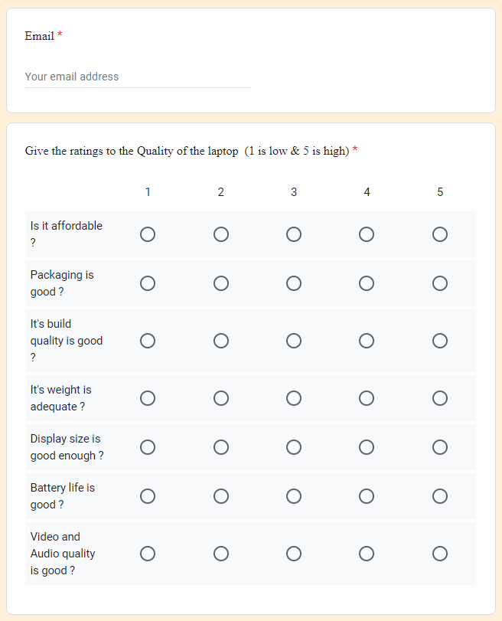
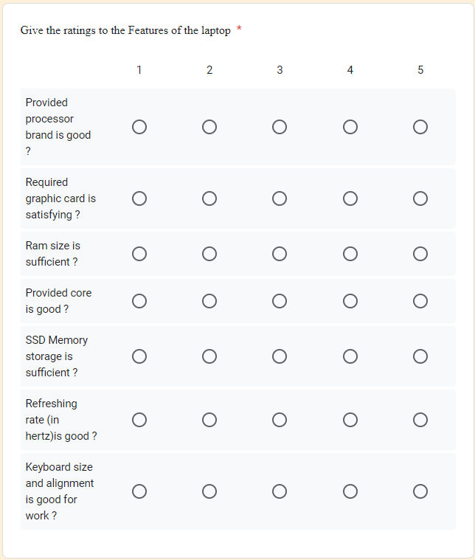
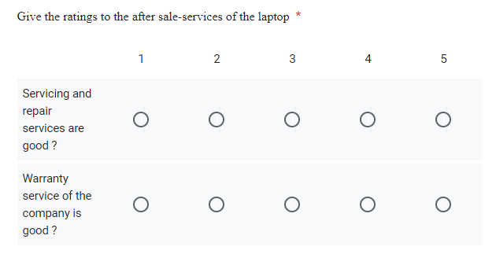
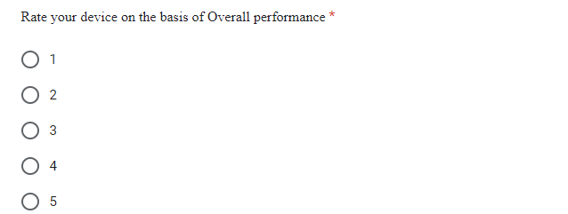
SURVEY FORM :-

Slide 8
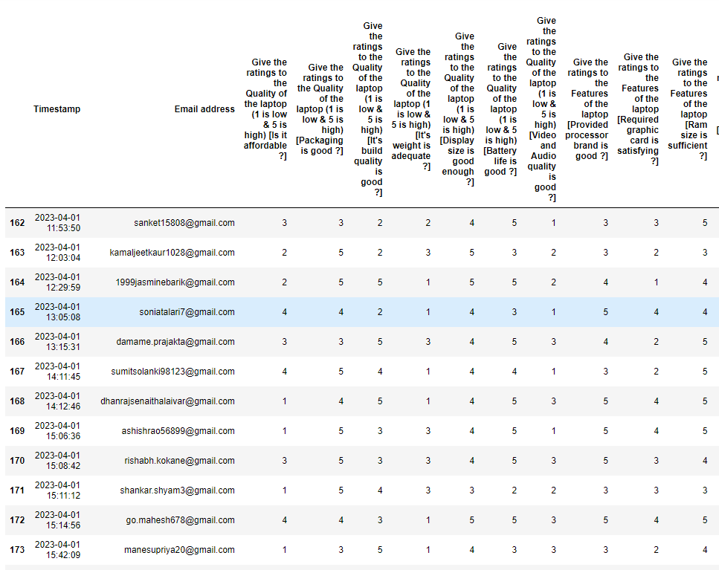
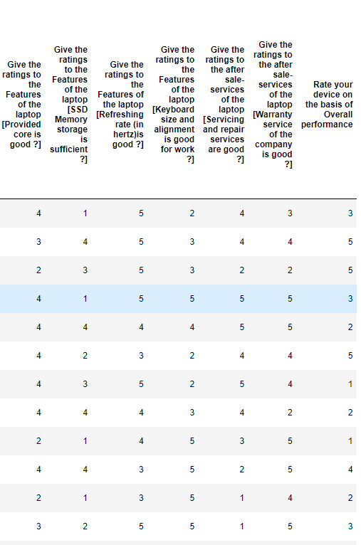
DATA SNAPSHOT :-

Slide 9
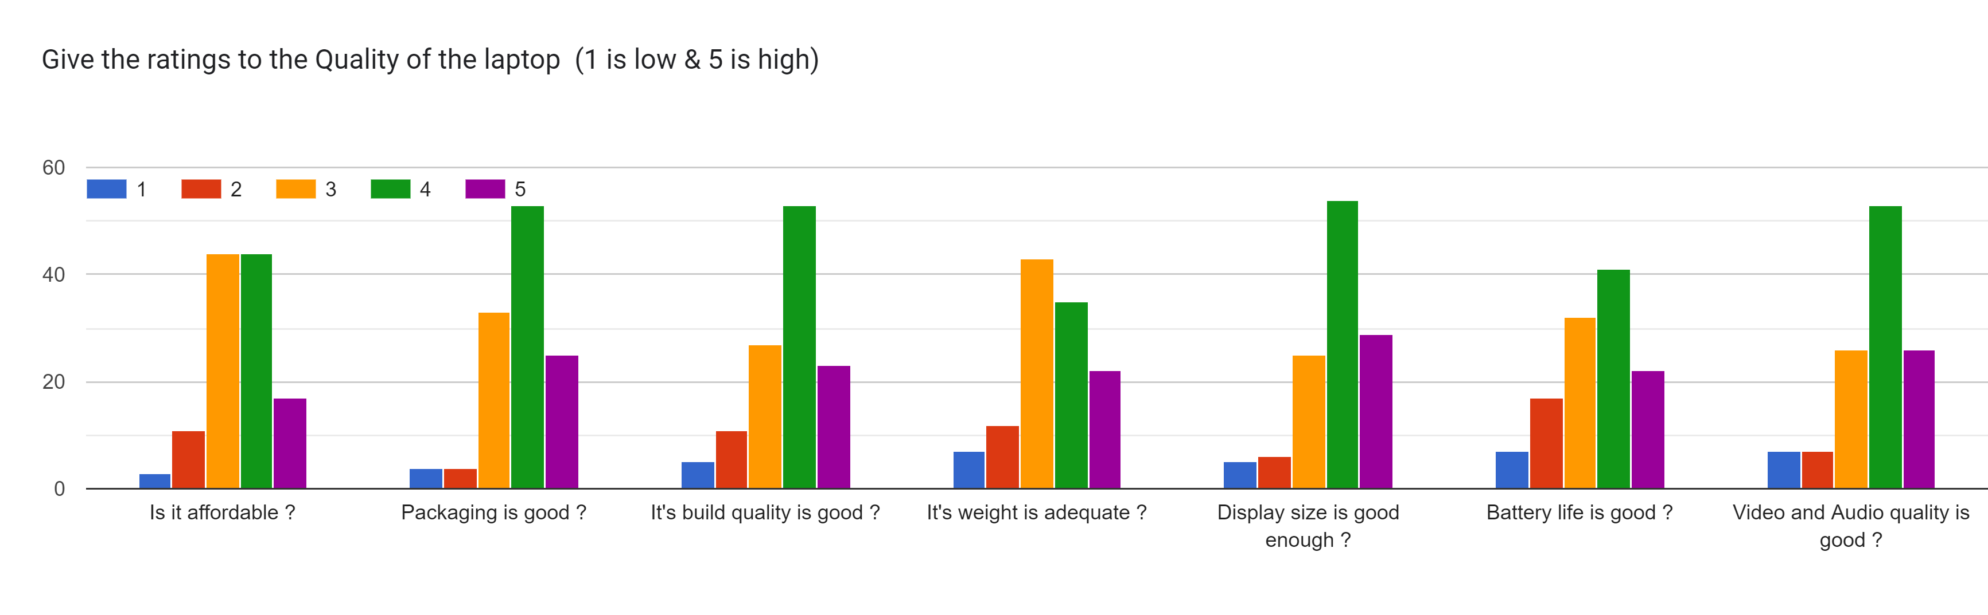
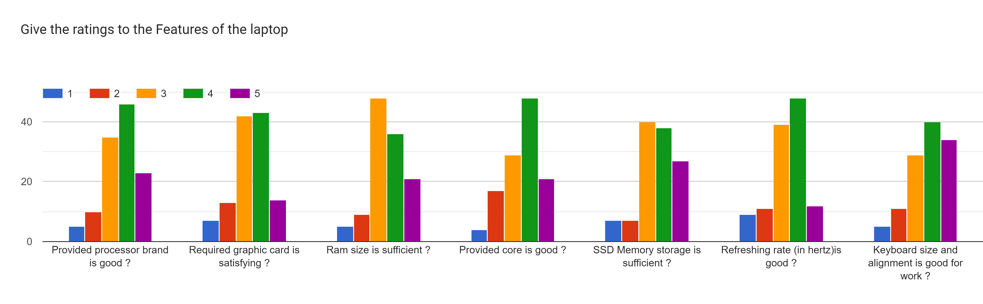
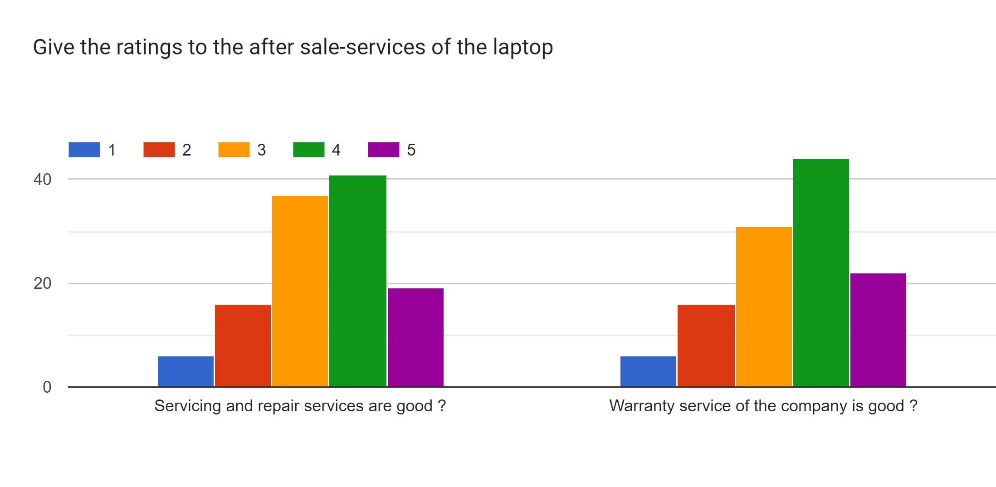
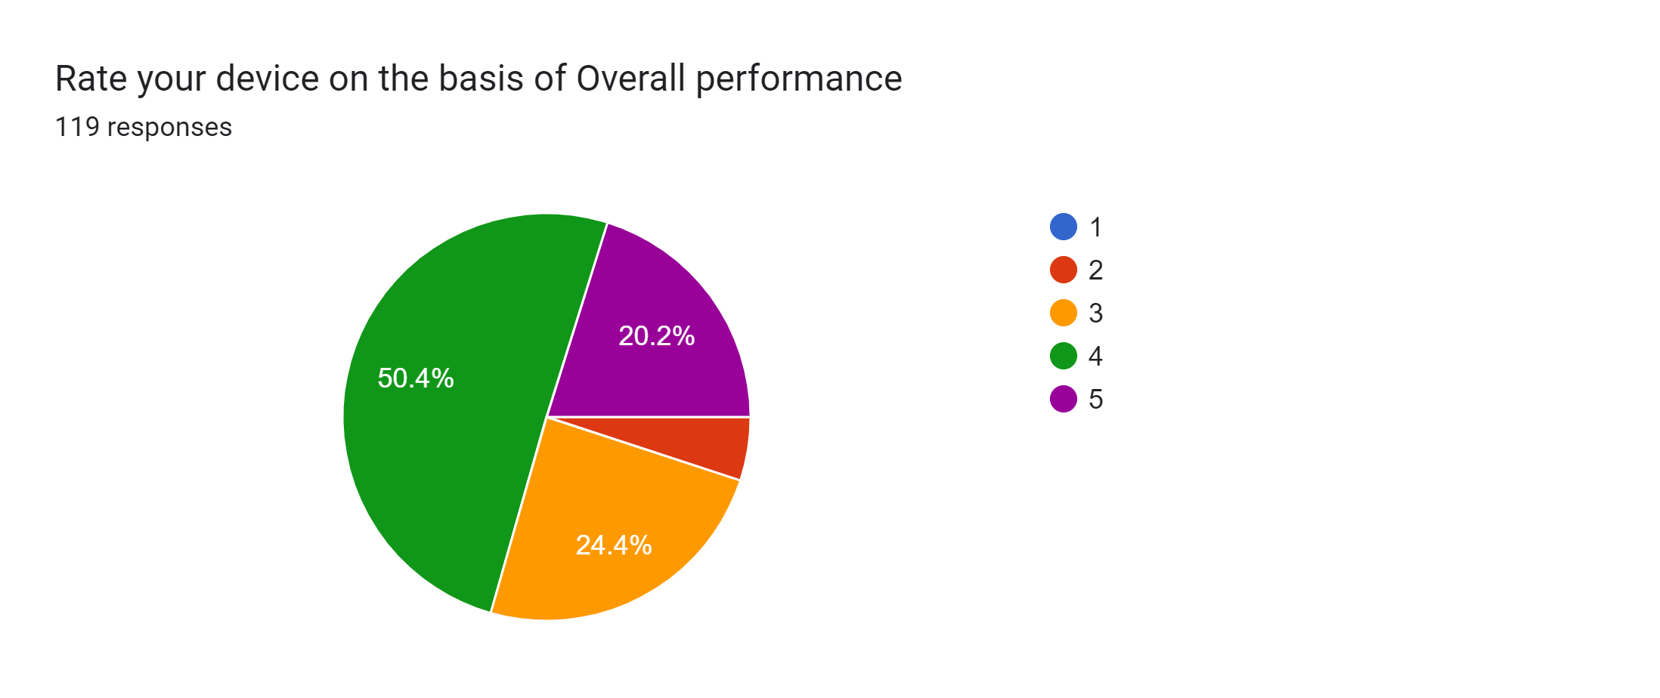


Slide 10
Checking for Adequacy of the Data
WE WANT CHECK THAT OUR DATA IS GOOD ENOUGH TO PERFORM FACOR ANALYSIS
WE GOING TO CHECK THOSE TO METHODS ARE SATISFIED OR NOT ?
Kaiser-Meyer-Olkin (KMO) measures :-
KMO value >=0.5 – Acceptable
KMO Value = 0.875085107721173 KMO value <0.5 – Unacceptable
Bartlett's test of sphericity :-
Bartlett’s test for sphericity tests the null hypothesis that the correlation matrix is an identity matrix.
H_{o}: Correlation matrix is an identity matrix V/S H₁:Correlation matrix is not an identity matrix
Chi square = 1146.8863434011582
P value 0.00
So, here H0 is rejected
Both conditions are satisfied.

Slide 11
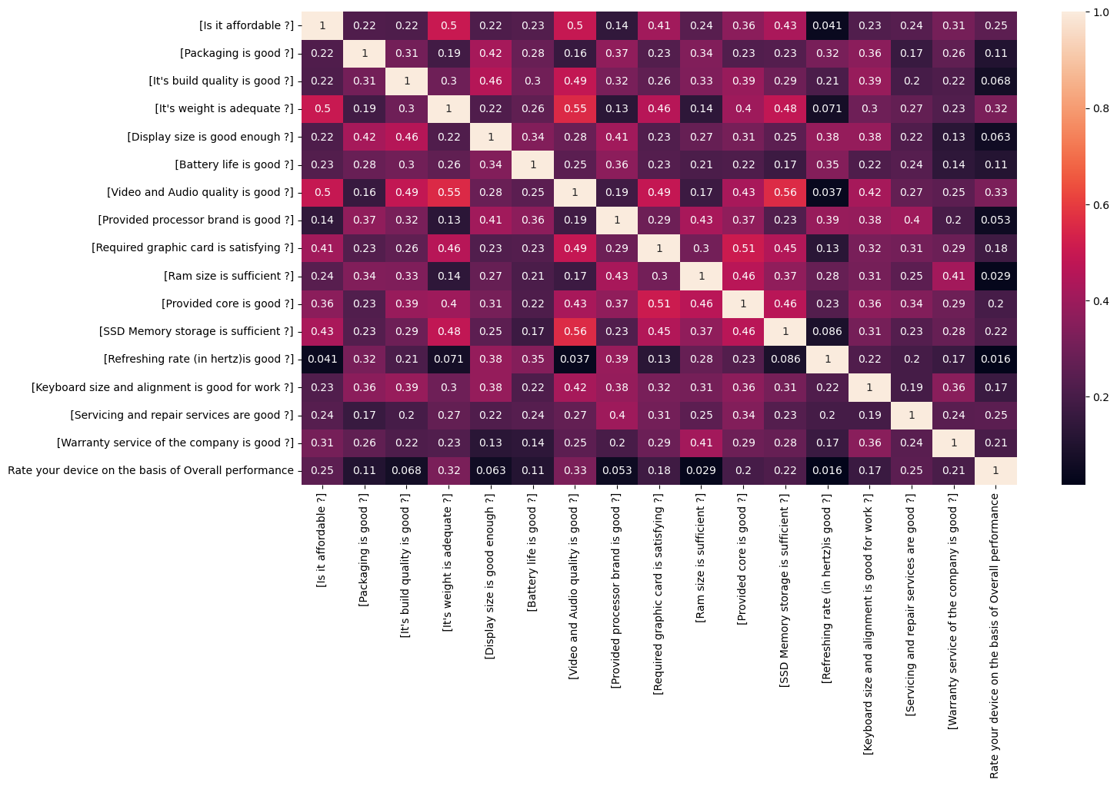
Correlation Matrix:-

Slide 12
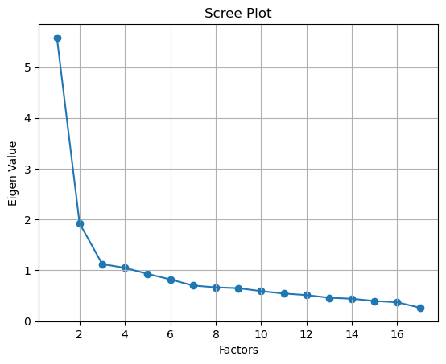
HOW MANY FACTOR WE HAVE EXTRACTED ?
FROM THE GIVEN SCREE PLOT WE CAN FIND OUT HOW MANY FACTORS WE HAVE TO EXTRACTED
SCREE PLOT
THE GRAPH OF
EIGEN VALUES v/s FACTORS
WE MAINLY SELECTED THE NUMBER OF FACTOR WHERE THE EIGEN ARE MORE THANE 1.

Slide 13
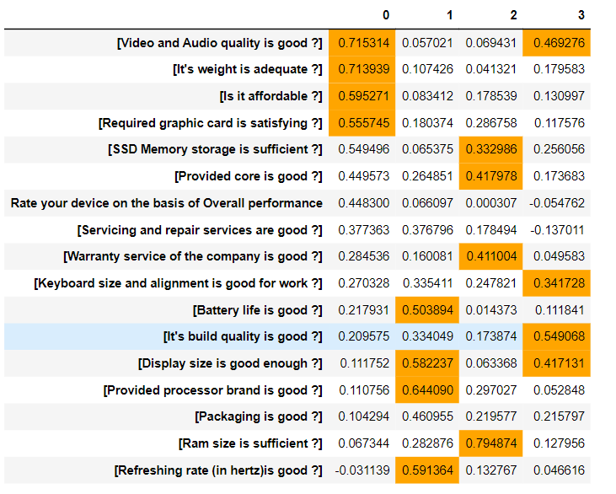
Factor Loadings :-
For the factor loading we use varimax rotation method.

Slide 14
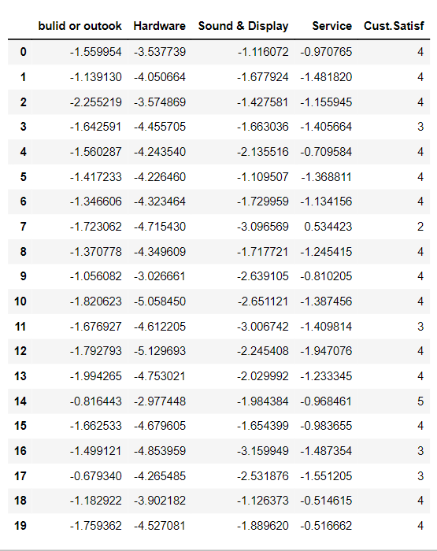
Factor Score :-

Slide 15
Linear regression
Now, we just done factor analysis. We reduce variable into 4 new variables.
We going to apply regression on that new variables for prediction.
First we have to check the assumption for linear regression are satisfied are not ?
Assumption :
Independent variables
Homoscedasticity
Normality
Linearity
Multicollinearity
Correlation matrix

Slide 16
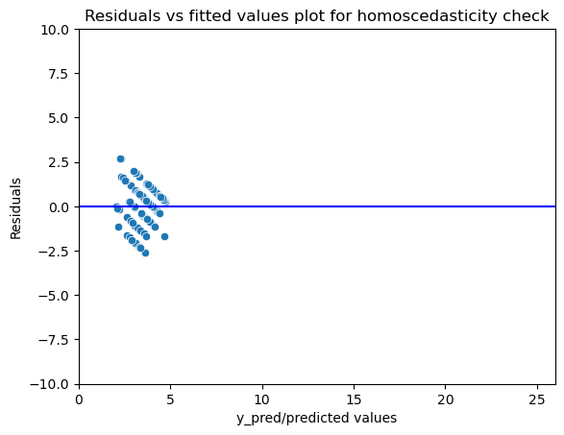
HOMOSCADESTISITY :-
Homoscedastic (also spelled "homoscedastic") refers to a condition in which the variance of the
residual, or error term, in a regression model is constant.
Above, diagram we clearly see that they have equal variance. So, homoscedasticity is present in data

Slide 17
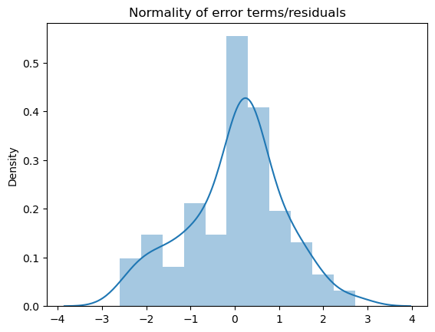
NORMALITY :-
Residuals in Linear Regression are the difference between the actual value and the predicted value.
here we clearly see that the residuals are normally distributed

Slide 18
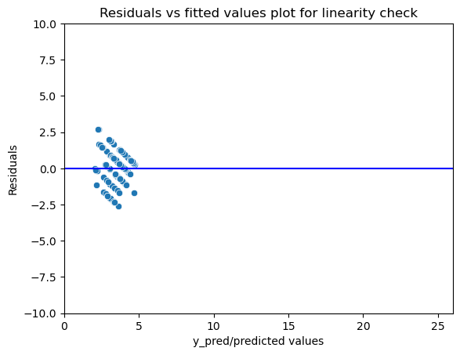
LINEARITY :-
We can check the linearity of the data by looking at the Residual vs Fitted
plot. Ideally, this plot would not have a pattern where the red line (Lowes
smoother) is approximately horizontal at zero. In the above plot we can see
that there is a clear pattern in the residual plot.

Slide 19
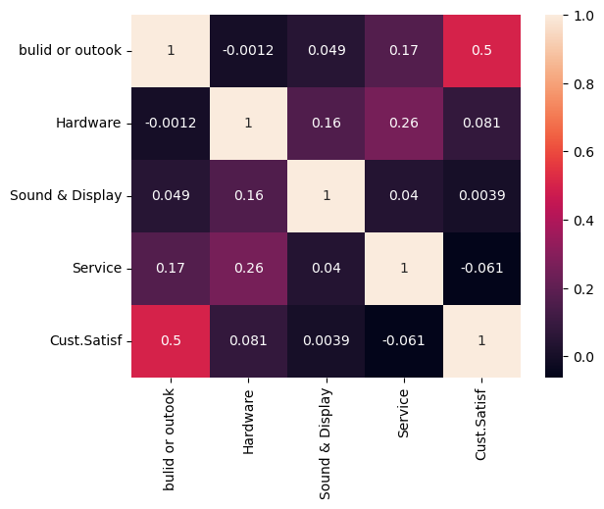
Correlation matrix :-
There is no multicollinearity is present in our data. Because there is no high correlation between the variables.

Slide 20
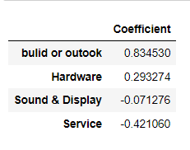
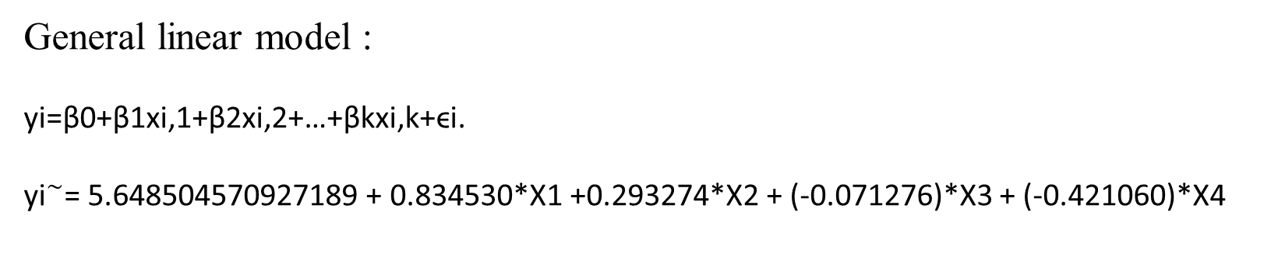
Here, our all assumptions are satisfied now we applying linear regression on our new dataset (factor score)
General linear model :
yi=β0+β1xi,1+β2xi,2+…+βkxi,k+ϵi.
${\text{yi}}^{\sim }$= 5.648504570927189 + 0.834530*X1 +0.293274*X2 + (-0.071276)*X3 + (-0.421060)*X4

Slide 21
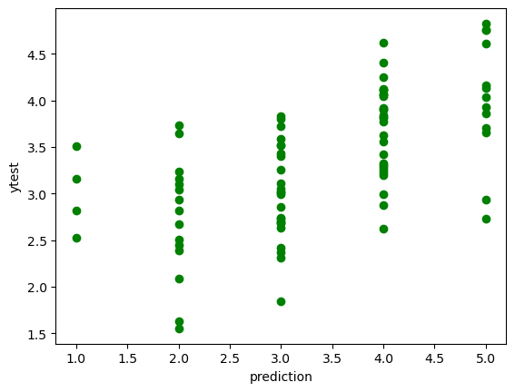
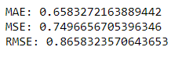



TRANING AND Testing our data using python
Predicting our test data
R square :- 0.30
MAE = 0.65832
MSE = 0.74966
RMSE = 0.865832

Slide 22
Conclusion :-
Holding all other features fixed, a 1 unit increase in Build or Outlook is associated with an *increase of 0.834530*.
Holding all other features fixed, a 1 unit increase in Hardware is associated with an *increase of 0.29327*.
Holding all other features fixed, a 1 unit increase in Sound & Display is associated with an *decreases of -0.071276*.
Holding all other features fixed, a 1 unit increase in Service is associated with an *decreases of -0.421060 *.
There are two way that will make people attract to the HP laptop
1st way : - Company have to increases the quality of the Sound and Display and also the give better services to customer’s. That will make people satisfied with laptop
2nd way :- we can see that people are most satisfied by Build and Outlook and also with moderately satisfied with Hardware. We also suggest to company that they have to focus on build or outlook of the laptop. They have to give gaming look to laptop or unbreakable laptop. Also they have increases the storage of SSD , increases the graphic card and give a best intel processor according to cost range.

Slide 23
Thank You !

